Slide 1



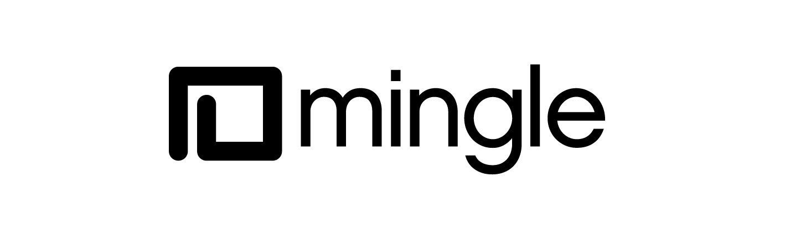



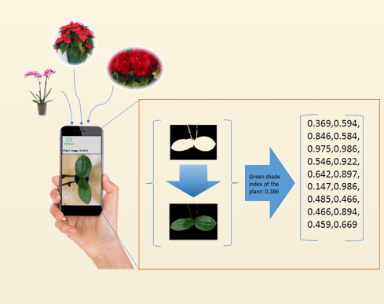
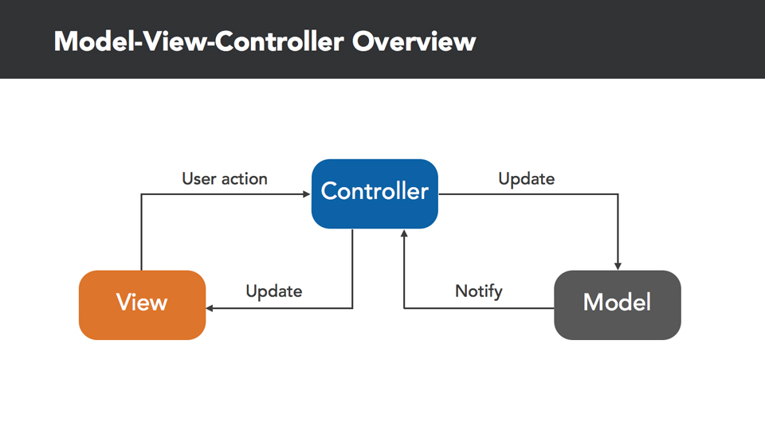
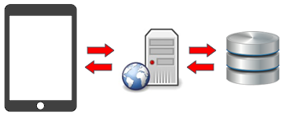
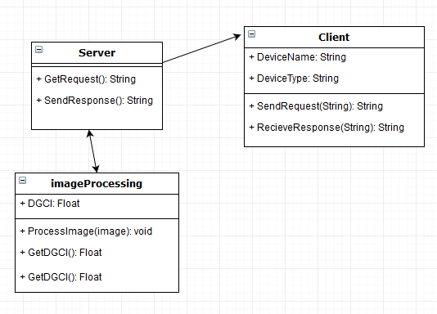
School of Computing & Information Sciences
Senior Project, 2018, Spring
Dr. Horticulture 1.0
Student: Cesar Reyes, Florida International University
Mentor: Dr. Khoddamzadeh, Product Owner
Professor: Masoud Sadjadi, Florida International University
Problem
Plants use fertilizers to increase the rate at which they produce the necessary nutrients for their development, but how much fertilizer does a plant needs? Conventional methods take weeks of processing time and need to destroy the plant in order to know the nitrogen content (Fertilizer) of the plant. This leads to overutilization of fertilizer in plants that costs money to the plant owners, and damages the environment.
Due to this, a tool that can quickly estimate a plant’s nitrogen would benefit agriculture workers, gardeners , and also help save the environment from the extra fertilizer wasted.
Solution
Dr. Horticulture iOS application aims to provide an easy and user friendly solution to measure the nitrogen levels of a plant and give fertilizing recommendations in order to save the user time and money, as well as helping the environment.
With Dr. Horticulture, users are able to take a picture of a plant, and the app will tell the user whether the plant needs to be fertilized or not. This is done by calculating how the colors of the plant differ from a healthy version of the same plant. Mat Lab, along with python, is being used for the back end of the application.
Current System
For this iteration, Dr. Horticulture tries to answer the question of whether a given plant needs fertilizer or not. It will lack the ability of telling the user how much fertilizer the plant needs, but it will be added as a feature on future iterations of the project as long as the login and user accounts.
Screenshots
System Design
Requirements
The System shall allow users to:
Login to their personal account
Take a picture of a plant by using the device’s camera.
Pick a picture from the device’s photo gallery.
Send a picture to the server in order to be processed.
Receive output from the server containing the results of the image processing algorithm.
Save results to their user account.
Display details results on their user account.
Model View Controller
Implementation
Dr. Horticulture’s back end implementation is made by integrating the following tools and programming languages:
MatLab R2017a
Python 3.6.4
Firebase
Matlab is used for the image processing algorithm, which applies filters to an image in order to get a DGCI(Dark Green Color Index) value that can be translated to the health of the plant.
Model-View-Controller system design is used for the presentation of the system in a mobile device in order to view picture’s scanning results.
Client-Server-Database
Verification
Client Server system design is used for the back end of the system for storing and processing user requests.
Test Case ID: Send_Camera_Picture (Sunny Day)
Purpose: Ensure that the system is able to take and send a picture to the server for processing.
Preconditions: The server is running, the user’s device has a working camera and the user has internet access.
Input: Once the app loads, the user clicks on the Plant Picker view, selects a desired plant, then selects the Camera button and takes the image, then click send.
Expected Result: Image is sent to the server for processing and a loading screen is show to the user.
Summary
Dr. Horticulture will provide the means for users to quickly measure and get an estimate of how much fertilizer a plant needs, allowing them to save money and time as well as saving the environment.
The app is developed so that future iterations are made possible in order to increase the accuracy of the readings as well as the user experience. We hope that with this application we can help the environment as well as decrease the costs of fertilizer for our users.
Object Design
Acknowledgement
The material presented in this poster is based upon the work supported by Dr. Khoddamzadeh. I am thankful to the help that I received from my group member Jose Nuñez
Notes:
1

